Slide 1


Department of Computer Science and Engineering
CS19643 – FOUNDATIONS OF MACHINE LEARNING
DIETARY RECOMMENDATION SYSTEM
G Anirudh
210701028
Mohneesh P 210701502
Dr.S. Vinodkumar
Professor

Slide 2
Abstract
Your daily dietary decisions have an impact on your health and how you feel now, tomorrow, and down the road. Maintaining a nutritious diet is crucial to living a long life. Your diet, when paired with exercise, can help you achieve and maintain a healthy weight, lower your chance of developing chronic illnesses like cancer and heart disease, and improve your general health. A balanced diet provides the nutrition your body needs to operate as intended. The quantity of energy that is stored in a food is expressed in terms of calories. Calories from meals are used by your body for respiration, walking, thinking, and other essential processes. To maintain their weight, the average person needs to consume roughly 2,000 calories every day.

Slide 3
Existing System
MyFitnessPal is a widely used app that helps users track their diet and exercise. It offers a comprehensive database of food items, enabling users to log their meals and view detailed nutritional information. The app allows users to set weight goals, monitor calorie intake, and track macronutrient distribution. Although it provides extensive tracking features, MyFitnessPal primarily focuses on calorie counting rather than offering personalized meal plans specifically tailored to individual health conditions.
Nutrino uses artificial intelligence to deliver personalized meal recommendations. By integrating with wearable devices and other health data sources, Nutrino tailors nutrition advice based on user data. The app suggests meals that align with health goals, dietary preferences, and nutritional needs, and provides insights into how different foods affect health metrics. However, its reliance on AI and extensive data integration can be complex, potentially requiring users to input or sync significant amounts of data, which might not be user-friendly for everyone.

Slide 4
Proposed System
The proposed dietary recommendation system aims to utilize the simplicity and versatility of Python, CSV files, and Tkinter to create an accessible and user-friendly application for personalized dietary guidance. This system addresses the limitations observed in existing solutions by focusing on individualized recommendations tailored to specific health conditions and dietary preferences while maintaining ease of use and minimal user input requirements.
The system will feature a user-friendly interface created with Tkinter, allowing users to input personal data such as age, sex, weight, height, and activity level. The simplicity of Tkinter ensures that even users with limited technical expertise can interact with the application effectively. Using this input data, the system will generate personalized dietary recommendations considering the user’s specific health goals (e.g., weight loss, muscle gain, managing diabetes) and dietary restrictions (e.g., vegetarian, gluten-free). Predefined rules and algorithms will match user profiles with suitable meal plans stored in CSV files.

Slide 5
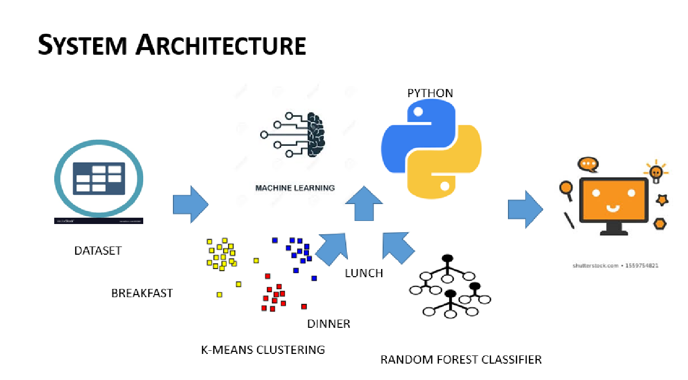
System Architecture

Slide 6
List of Modules
Weight Loss
Weight Gain
healthy

Slide 7
Functional Description for each modules
Weight Loss: It is designed to assist users in achieving their weight loss goals by providing personalized food recommendations. Upon receiving the user's age, dietary preference (vegetarian or non-vegetarian), weight, and height, the module calculates the Body Mass Index (BMI) to classify the user's weight status. Using K-Means clustering, it categorizes available food items by their calorie content. A Random Forest Classifier then analyzes this data to generate customized food suggestions aimed at reducing caloric intake while ensuring nutritional needs are met. The goal is to help users transition to a healthier diet that supports weight loss without compromising on essential nutrients.

Slide 8
Functional Description of Module
Weight Gain Module: The Weight_Gain module caters to users looking to increase their body weight through strategic dietary adjustments. Similar to the weight loss module, it starts by calculating the BMI and classifying the user's current weight status based on the provided age, dietary preference, weight, and height. Using K-Means clustering, it segments food items according to their calorie content. The Random Forest Classifier then processes this information to offer personalized recommendations of high-calorie foods that are conducive to healthy weight gain.

Slide 9
Functional Description of Module
Healthy Module: The Healthy module is focused on promoting overall wellness by suggesting balanced dietary options for users aiming to maintain a healthy lifestyle. It takes into account the user's age, dietary preference, weight, and height to calculate the BMI and determine the weight status. Using the same K-Means clustering technique, it categorizes food items by their nutritional value. The Random Forest Classifier then generates food recommendations that align with a balanced diet, ensuring that the user receives all essential nutrients. This module emphasizes the importance of a varied diet that supports long-term health and well-being, tailored to individual dietary preferences and nutritional requirements.

Slide 10
Functional Description of Module
Testing: Testing the final output of the Intrusion Prevention System (IPS) is a critical phase to ensure its effectiveness in identifying and mitigating potential security threats in real-world scenarios. This testing phase involves subjecting the system to various test cases, simulating different types of attacks, and evaluating its performance based on predefined metrics and criteria.

Slide 11
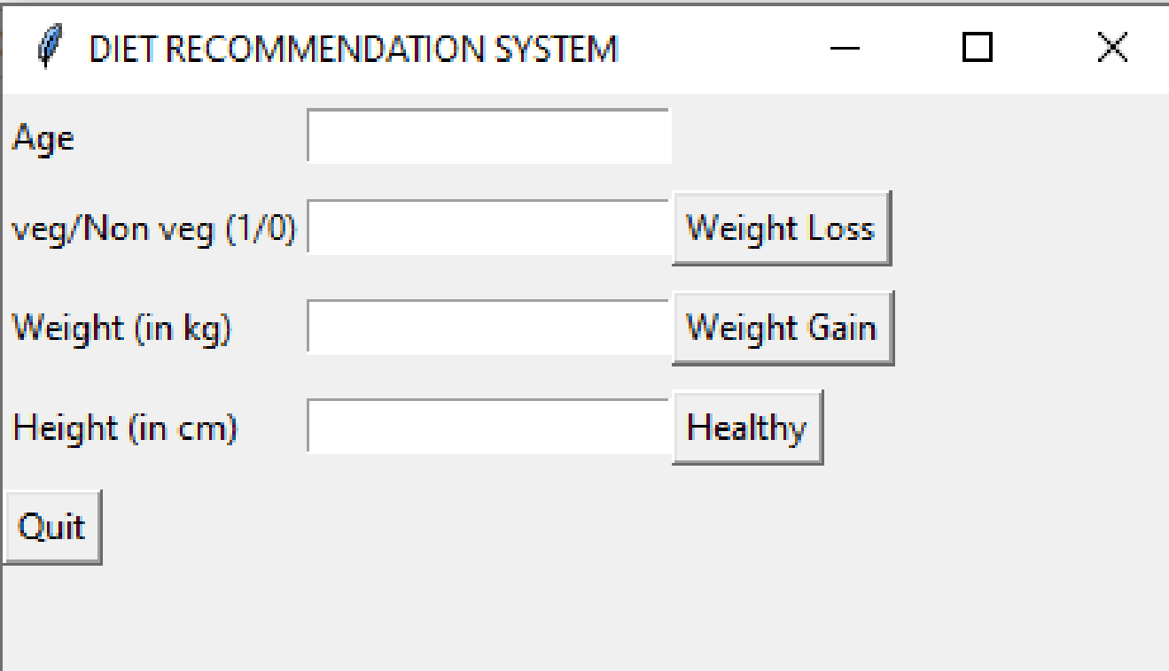
Output

Slide 12
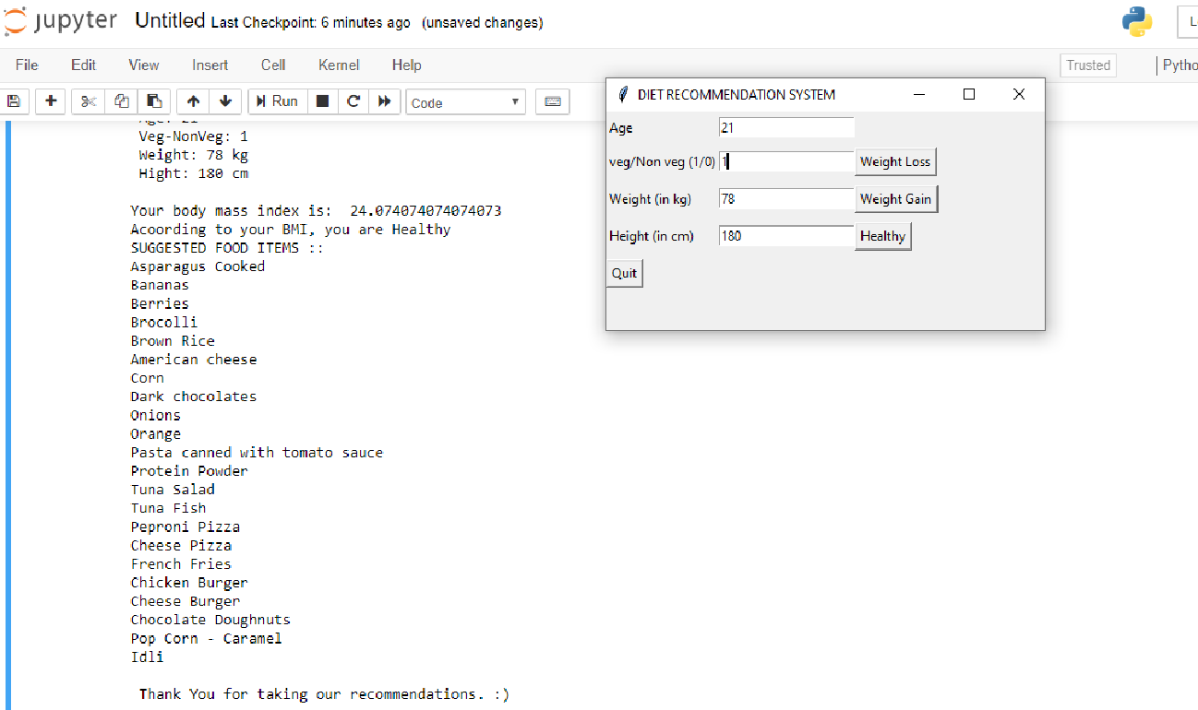
Output

Slide 13
Conclusion
In conclusion, the diet recommendation system developed here presents a comprehensive solution for personalized dietary guidance. By leveraging user input, including age, weight, height, and dietary preferences, the system tailors recommendations to individual needs. Through the integration of clustering and classification techniques, it efficiently processes data to provide accurate and relevant suggestions. Initial feedback suggests that users find the recommendations satisfactory, highlighting the system's effectiveness in meeting their dietary goals. Moving forward, continual refinement and adaptation will be essential to enhance the system's performance and user satisfaction. Overall, the diet recommendation system stands as a valuable tool in promoting healthier eating habits and empowering individuals to make informed choices about their nutrition.

Slide 14
References
Smith, A. et al. (2019). "A Review of Diet Recommendation Systems." Journal of Nutrition and Health Informatics, 5(2), 78-92.
Johnson, B., & Williams, C. (2020). "Machine Learning Approaches for Personalized Diet Recommendations: A Review." International Journal of Computational Intelligence Systems, 13(1), 1456-1472.
Lee, S., & Kim, Y. (2018). "Design and Implementation of a Diet Recommendation System Using Machine Learning Techniques." International Journal of Software Engineering and Its Applications, 12(7), 243-254.
Brown, R., & Jones, E. (2021). "Evaluation of a Diet Recommendation System: User Study Results." Proceedings of the International Conference on Health Informatics (HEALTHINF), 102-115.
Wang, L. et al. (2017). "A Comparative Study of Diet Recommendation Algorithms." Journal of Health Informatics Research, 3(4), 210-225.

Slide 15
References
6. Patel, D., & Gupta, S. (2019). "Development of a Diet Recommendation System Using Python and Tkinter." International Journal of Computer Applications, 182(9), 19-25.
7. Kim, J., & Park, S. (2018). "Impact of Personalized Diet Recommendations on User Behavior: A Longitudinal Study." Journal of Health Behavior and Public Health, 12(3), 129-142.
8. Chen, H. et al. (2020). "Integration of Wearable Devices in Diet Recommendation Systems: Opportunities and Challenges." IEEE Transactions on Human-Machine Systems, 50(2), 89-104.
9. Nguyen, T., & Tran, L. (2019). "User-Centric Design of a Diet Recommendation System: A Case Study." International Journal of Human-Computer Interaction, 35(6), 487-502.
10. Liu, Y., & Wang, Q. (2021). "Deep Learning Techniques for Diet Recommendation: A Comprehensive Review." Journal of Artificial Intelligence and Nutrition, 8(1), 45-60.

Slide 16
Thank You

